Slide 1
Autonomous Vehicle Liability, Insurance and Regulation
Peggy Sharon, ADV
Levitan, Sharon & CO
Asia Pacific Insurance Conference October 2017

Slide 2
The Vision
‹#›

Slide 3
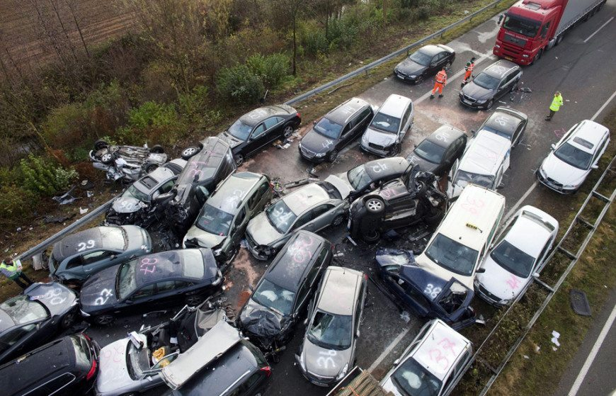
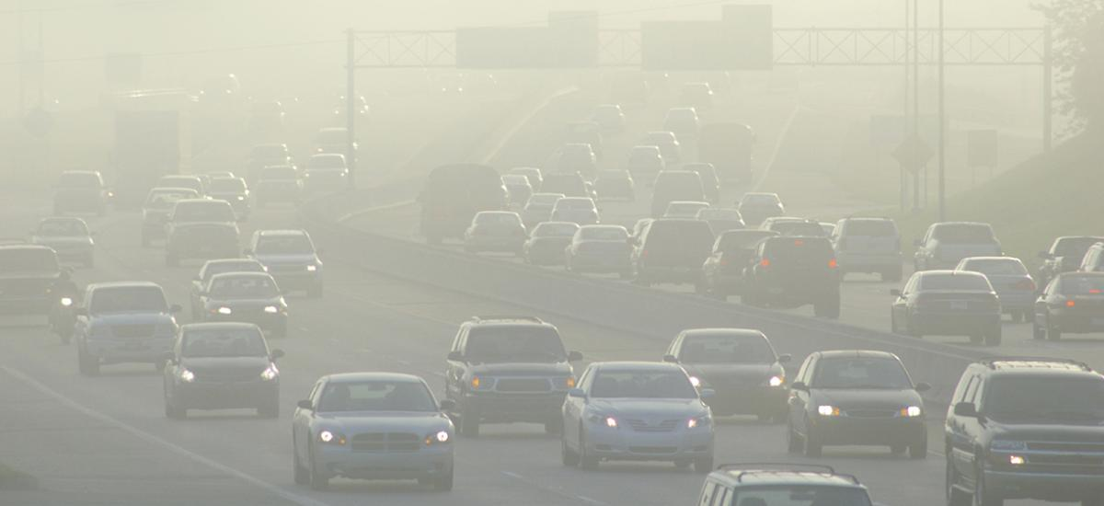
The Social Cost of Driving Today
Accidents
Traffic Jam
Noises
Air Pollution
‹#›

Slide 4
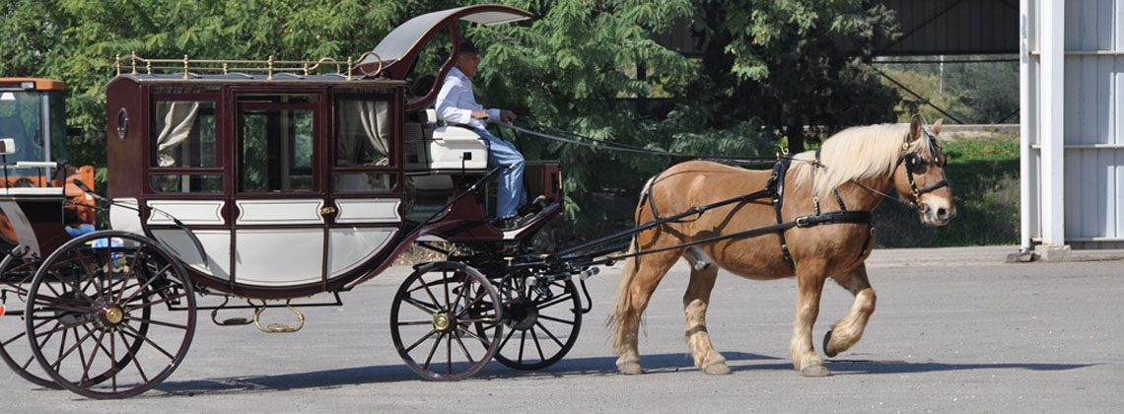
Safety Measures – Reducing Fatal Car Accidents
At the past, safety measures only in luxury cars. Step by step, Over decades Safety measures are applied in most of the cars.
For example – front air bags (1984), Electronic Stabilization Program (1995), Head-protecting Side Air Bags (1998), and forward collision warnings in 2000.
Based on the data from 1960 to 2011, the rate of fatalities has halved every two decades on U.S. roadways
‹#›

Slide 5
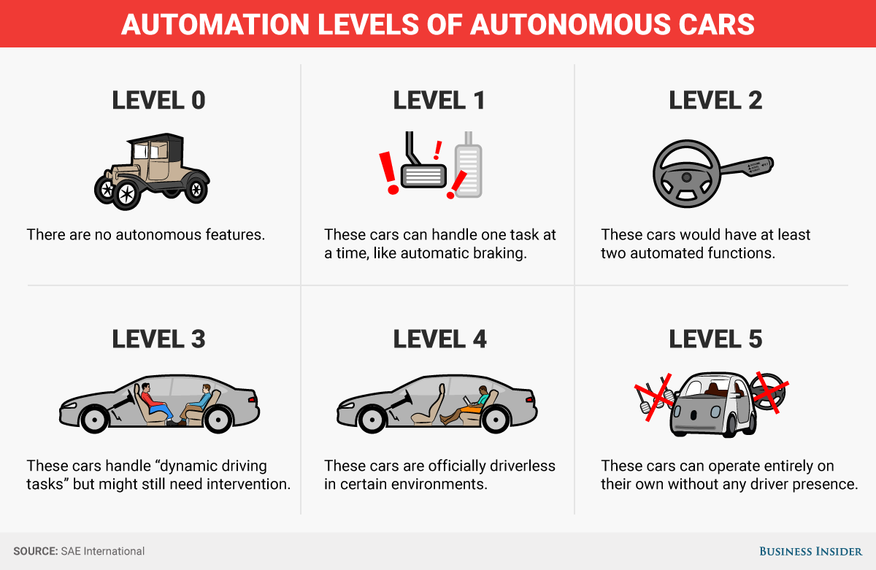
Autonomous Car Levels
‹#›

Slide 6
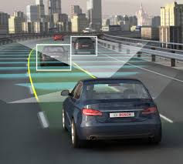
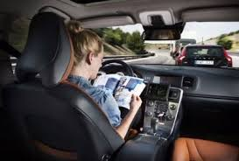
Autonomous Vehicles – Advantages
Eliminate results of human fallibility (intoxication, fatigue, aggressiveness, inexperience, lack of attention, etc.).
Increase traffic efficiency and accessibility.
Reduce carbon emissions.
freeing the driver to multitask during driving.
‹#›

Slide 7
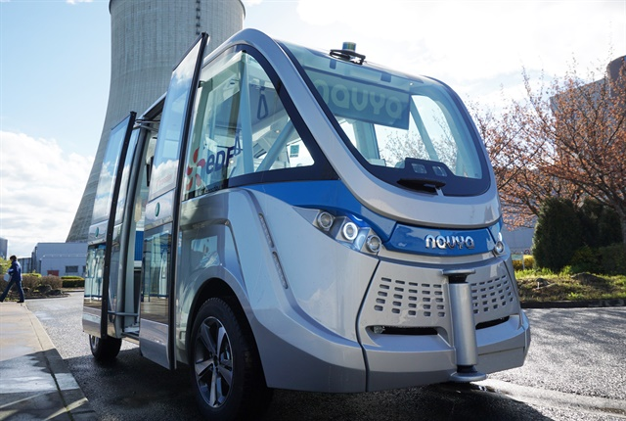
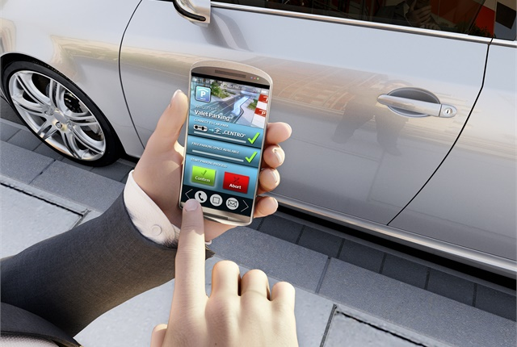
New Features With AV Technology
Automotive supplier Continental Demonstrates Automated Valet Parking.
South Australia Pushes for Autonomous EV Shuttle Bus.
‹#›

Slide 8
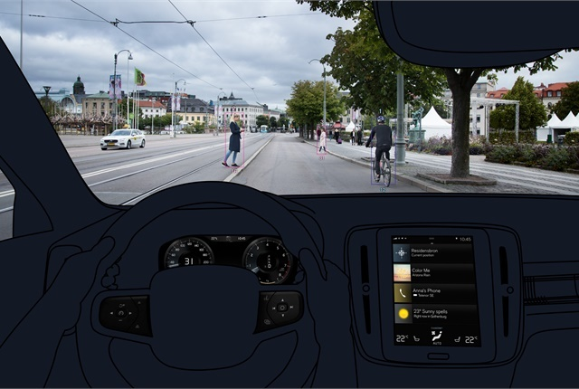
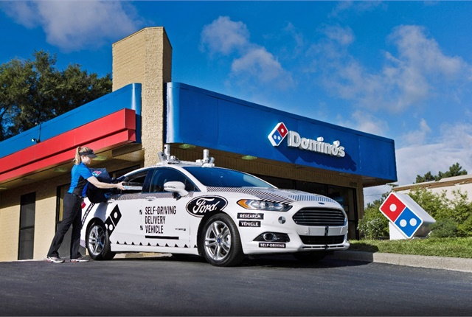
New Features With AV Technology
Testing methods for communicating a self-driving vehicle’s intent
Volvo XC40 Filled With Advanced Safety Features for urban areas too.
Domino’s Testing Self-Driving Fusion Hybrid for Pizza Delivery
‹#›

Slide 9
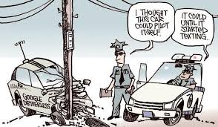
Autonomous Vehicles - Disadvantages
Increase vehicles motor traffic, thereby negatively impacting overall carbon emission.
AV software becomes standardized, a single flaw might lead to many accidents.
Risk of hacking.
Job losses (e.g. truck, cab and bus drivers).
Disrupt “crash economy” (e.g. healthcare providers, attorneys, insurance companies, and auto repairs).
‹#›

Slide 10
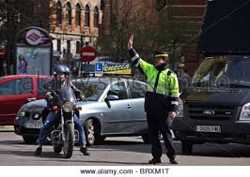
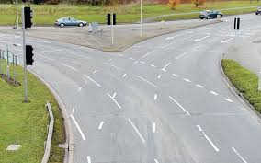
Autonomous Vehicles Difficulties
notice the lane marking on the road when it is covered by snow or obscured by intense rainfall or fog.
judging the behavior of pedestrians and other drivers.
recognize signals provided by guards or gestures from other drivers
‹#›

Slide 11
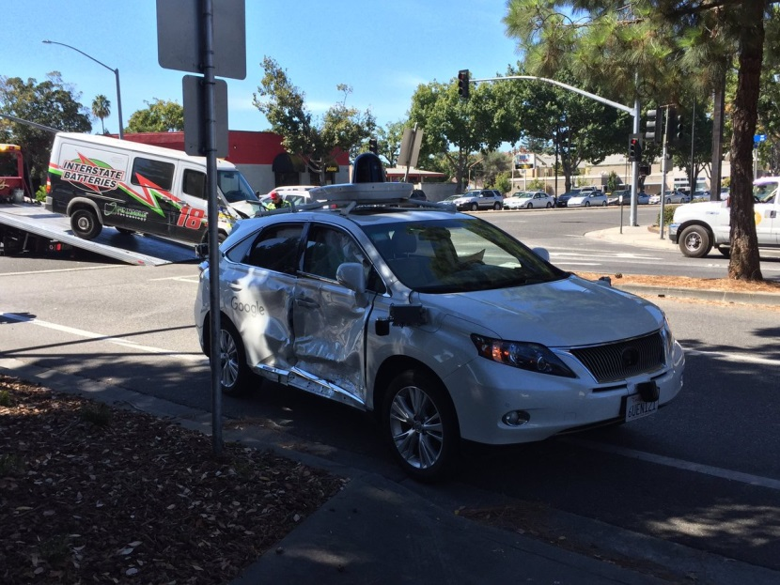
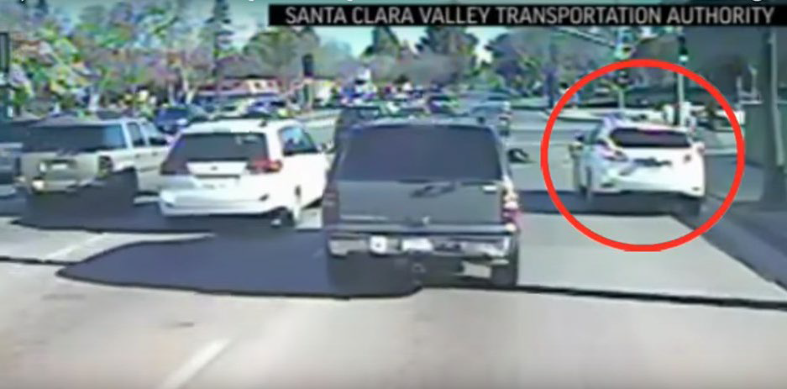
AV accidents and results
July 2016 - the first fatality from an autonomous vehicle (TESLA). The crash killed the vehicle’s owner.
march 2017 – Uber vehicle crashed in Arizona as a result Uber delayed the ambitious self-driving car.
September 2016 - Google autonomous car was involved in a car accident after he couldn’t stop on time when regular vehicle pass a red traffic light.
‹#›

Slide 12
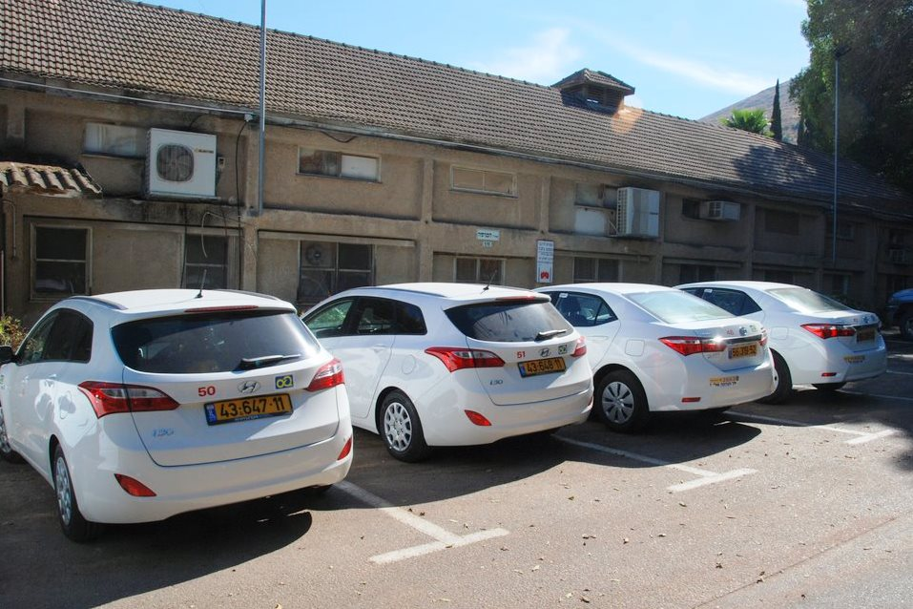
Social Catastrophe
Lack of family/social life.
Public Transportation will be used only by few.
Too many autonomous vehicles on the road at the same time.
‹#›

Slide 13
Liability
‹#›

Slide 14
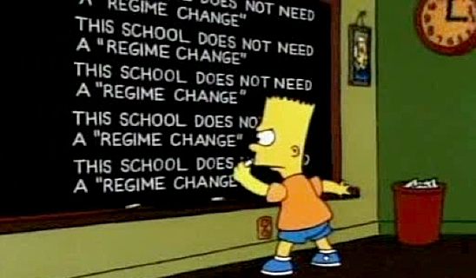
what Liability Regime is suitable?
Liability theories: negligence, non-fault and strict liability.
Until full automation: strict liability Convenient for implementation compared with product liability claims.
Disadvantage: Concern that a strict liability may deter manufacturers from developing full autonomous vehicles technology.
Possible solution: pricing the risk in the vehicles cost.
Future vision – less accidents but the accidents will be More expensive and deadly then now.
Different kinds of accidents.
‹#›

Slide 15
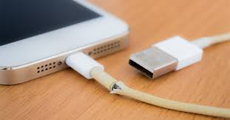
product liability
Negligence and Probability Tests or utility-cost test.
Strict product liability.
Types of defects: Manufacturing or Production Flaw, Design Defect, Defective Warnings or Instructions.
Interaction between man and computer (software) until full automation.
‹#›

Slide 16
Insurance
‹#›

Slide 17
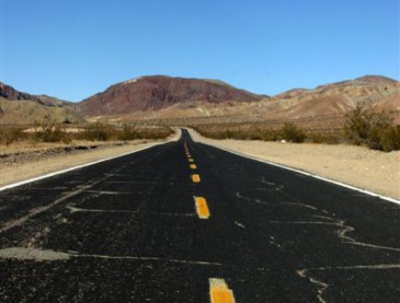
Insurance Industry - prediction
The size of the automobile insurance pie will likely shrink - estimation of 40% dropping until 2040.
commercial lines could take a larger share, as the marketplace moves towards car sharing and mobility on demand.
The potential liability of the software developer and manufacturer will increase too.
Increase of liability insurance for maintenance of vehicles from vehicles owner and manufacture.
‹#›

Slide 18
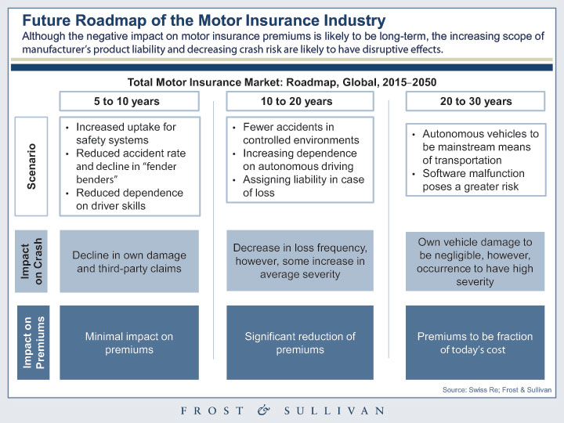
Impact on Insurance Industry
o
‹#›

Slide 19
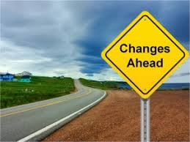
Changes in the Insurance Industry
Changes in procedure for handling claims (documents types and evidence).
Underwriting stage will change according to the development of technology (lack of history).
Regulatory control over the level of premiums – Difficulties in determining the premium.
‹#›

Slide 20
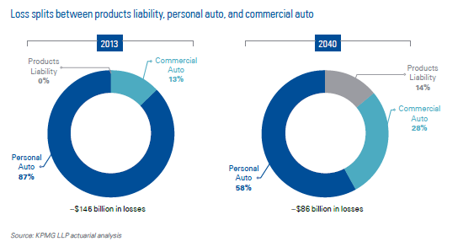
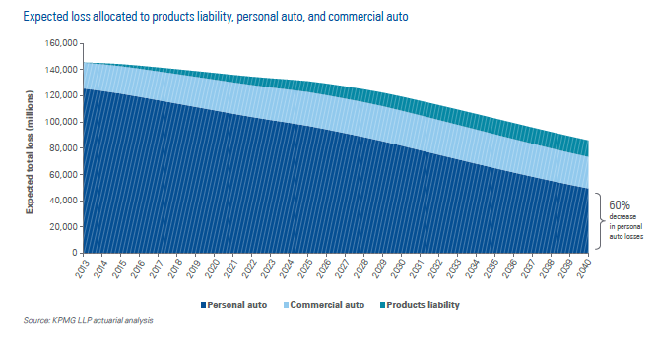
Expected trends in vehicles insurance
‹#›

Slide 21
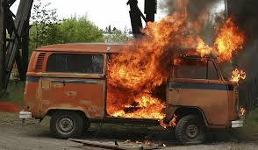
Cybersecurity
growing concern for cyber attacks on autonomous vehicles. The risks:
Taking control over the vehicle.
Collect data about your personal life.
Terror attack
Is it manufacturer/consumer or state responsibility ?
In December 2013 Target was attacked by hackers who stole 110M consumer credit data.
Cybersecurity insurance is designed to mitigate losses from a variety of cyber incidents.
‹#›

Slide 22
What questions should be asked by the insurance market
What is autonomous vehicles? (disadvantages, shelf life of parts, etc).
requirements regarding maintenance?
Which new insurance product will reduce the driver's "moral hazard“?
‹#›

Slide 23
Regulation
‹#›

Slide 24
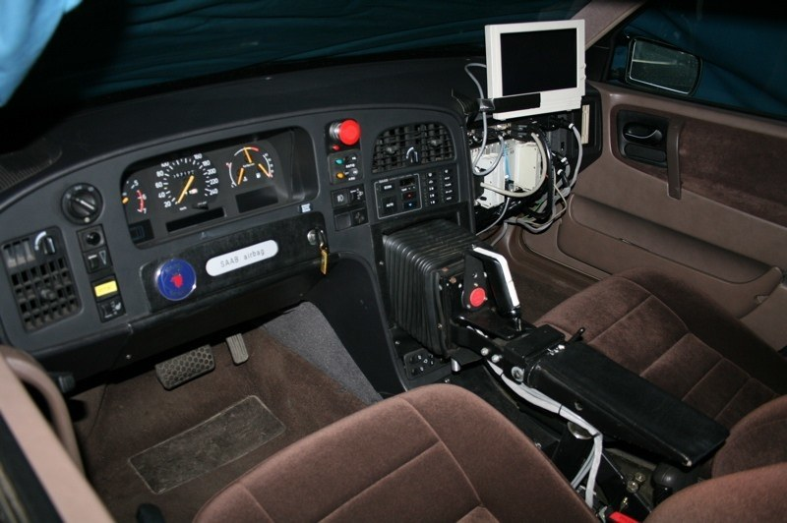
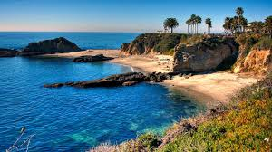
Recent Developments in Regulation
In 2017, 33 states in USA have introduced legislation related to AV.
California senate - autonomous vehicles need not be equipped with a steering wheel, a brake pedal, an accelerator, or an operator inside the vehicle.
Michigan senate – allows operation without a person in the autonomous vehicle.
Mercedes start to develop autonomous truck. It should be ready in 2025.
‹#›

Slide 25
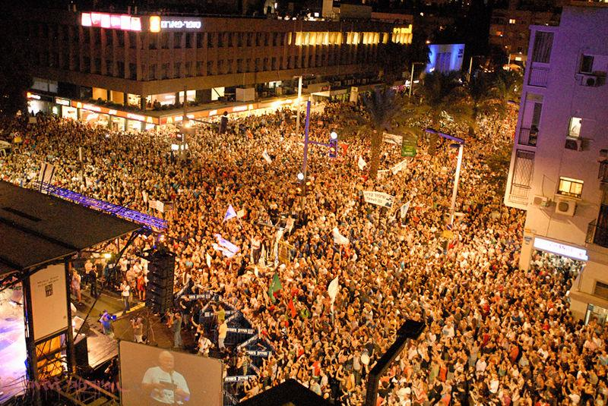
recommendations
Create forum for private insurance industry, regulators and manufacture on issues of traffic safety.
Monitor developments worldwide concerning the regulation of semi-automated and self-driving vehicles
develop policy wordings in coordination with regulators.
‹#›

Slide 26
The Gold Rush Hour
Not only focused on the immediate innovation. Companies are looking to earning money.
Google bought for 15 billion dollar Mobileye, which makes self-driving sensors and software.
Other opportunities:
Data by the terabyte.
CPUs on board.
Open source opportunity.
Dynamic capabilities.
‹#›

Slide 27
Thanks!
‹#›

Slide 28
Peggy Sharon, ADV
Levitan Sharon & CO
Asia Pacific Insurance Conference October 2017

